Slide 1

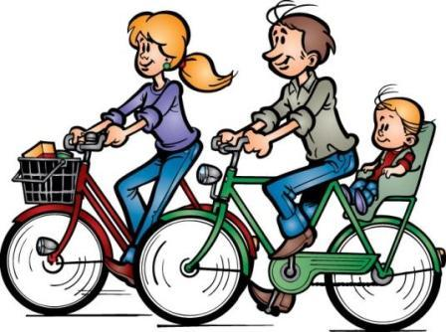

Slide 2
jokplmotherk
hgrfatherokui
jthfsvjosonulf
ksrdaughteryw
kbrotheruhfbp
hgysisterjmng
gtyhauntglmo
hunclenyhkja

Slide 3
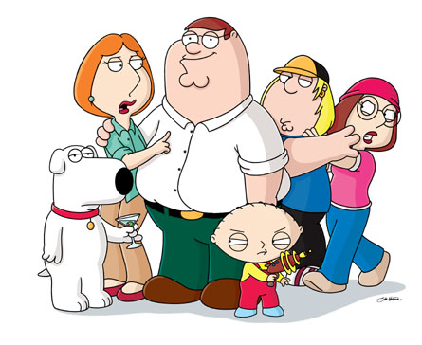
jokplmotherk
hgrfatherokui
jthfsvjosonulf
ksrdaughteryw
kbrotheruhfbp
hgysisterjmng
gtyhauntglmo
hunclenyhkja

Slide 4

Family members:
Grandmother - бабушка
Grandfather - дедушка
Father – папа
Mother - мама
Sister - сестра
Brother - брат
Son - сын
Daughter - дочь
Aunt - тетя
Uncle – дядя
Cousin – двоюродный брат

Slide 5
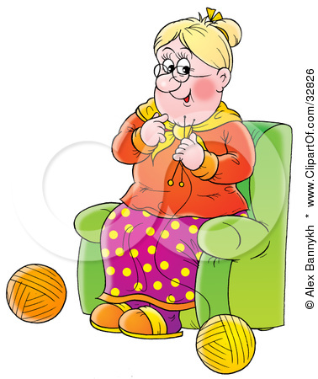
parents – родители
pensioner - пенсионер

Slide 6
I – am
He
She - is
It
We
You - are
They

Slide 7

This is me. My name is Oleg. I am eleven. I am a schoolboy.

Slide 8
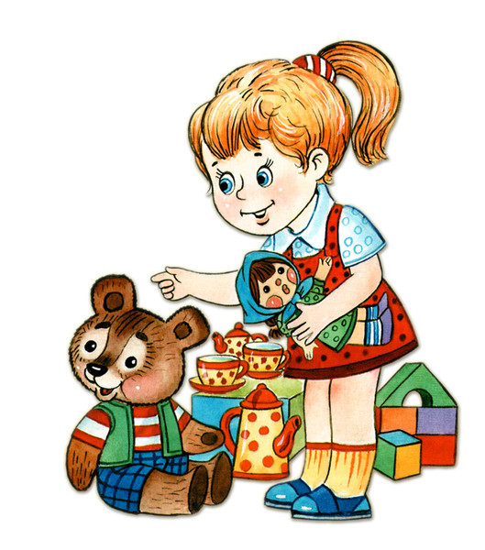
This is my sister. My sister's name is Sveta. She is five. She is not a schoolgirl. She like play with a cat.

Slide 9

I have a brother. My brother, s name is Misha. He is twenty and he is a student. Misha is a good brother.

Slide 10
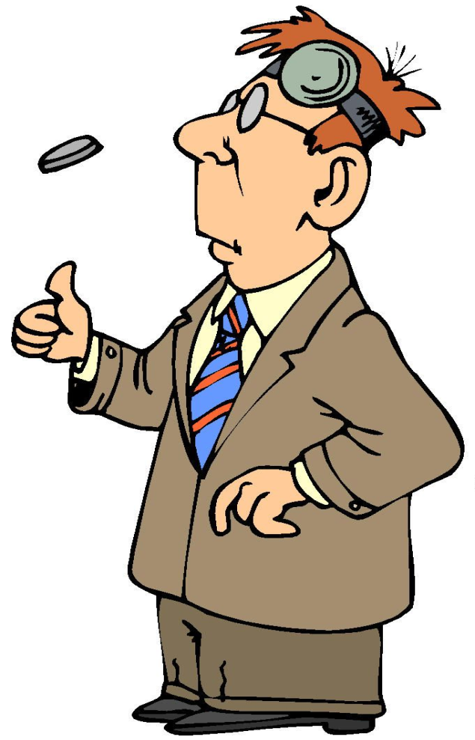
This is my father. I am his son. Sveta is his daughter. My father, s name is Sergey Petrovich. He is a doctor.

Slide 11

This is my mother. Her name is Polina Victorovna. My mother is a teacher. She is kind and clever. My mother and my father are my parents.

Slide 12
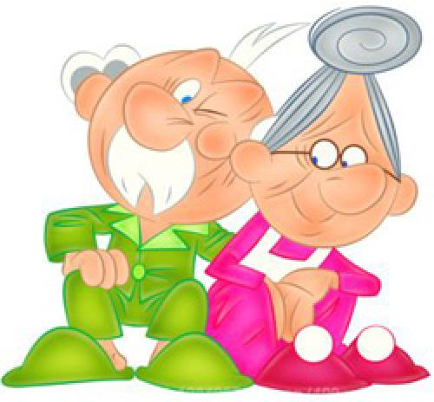
These are my grandfather and grandmother. They are pensioners. My grandfather and grandmother are very nice.

Slide 13

This is my dog. The dog, s name is Rex. It is very clever.

Slide 14
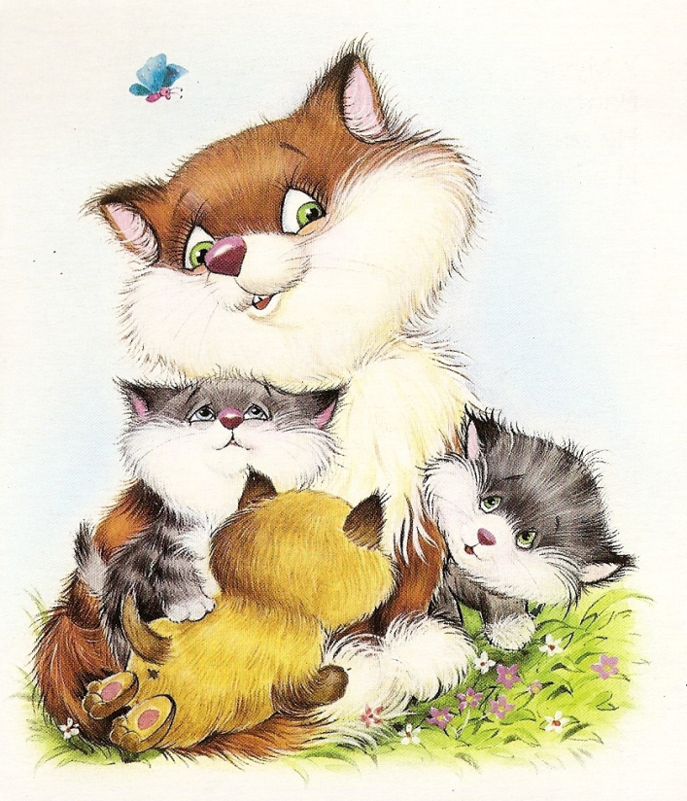
This is my cat. The cat, s name is Myrka. It is funny.

Slide 15


This is my family. It is not very large. We are happy!

Slide 16


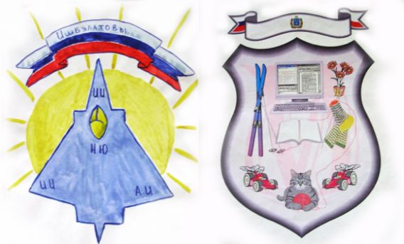

Герб
Геральдика

Slide 17
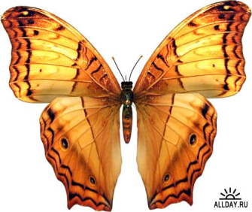
!
The lesson is over!
Good bye!

